Slide 1
Introduction
A Human Resource (HR) Database Management System is designed to store, manage, and analyze employee-related information efficiently within an organization. It helps HR departments maintain structured records of employees, departments, job roles, salaries, dependents, and organizational hierarchy.
In this project, we use SQL and MS SQL Server to design and manage an HR database that allows efficient data retrieval, manipulation, and analysis. The system demonstrates how relational database concepts such as tables, joins, subqueries, grouping, and aggregate functions can be used to handle real-world HR data.
The database includes multiple interconnected tables such as employees, departments, jobs, locations, countries, and regions. Using SQL queries, we perform operations like retrieving employee information, analyzing salary data, identifying department statistics, and understanding reporting structures within the organization.
This project aims to demonstrate practical database management skills and show how SQL queries can support decision-making in HR operations by transforming raw data into meaningful insights.

Slide 2
Key Findings
Employee Distribution by Department The analysis showed how employees are distributed across different departments, helping identify departments with the highest and lowest workforce.
Salary Analysis By using aggregate functions such as AVG, MAX, and MIN, the system identifies salary trends, including the highest salary, lowest salary, and average salary within each department.
Department Headcount The database queries revealed the number of employees working in each department, allowing HR to easily track department sizes and workforce allocation.
Manager–Employee Relationships The system helps identify managers and their direct reports, providing insights into the organizational hierarchy and reporting structure.
Employees with Dependents Using SQL queries, the system can determine which employees have dependents and which employees do not, helping HR manage employee benefits and family-related records.
Department Salary Expenses The total salary expenditure per department was calculated, which helps in understanding the budget allocation for each department.
High and Low Salary Employees Employees were categorized based on salary levels (Low, Average, High), enabling quick identification of compensation ranges within the organization.
Employee Location Analysis By using subqueries, employees working in specific locations (such as location ID 1700) were identified, helping in geographical workforce analysis.

Slide 3
Actionable Insights
Optimize Workforce Allocation Departments with very high or very low employee counts should be reviewed. HR can redistribute resources or recruit additional staff to maintain balanced workloads.
Salary Structure Improvement By analyzing minimum, maximum, and average salaries across departments, HR can ensure fair compensation and identify employees who may require salary adjustments.
Strengthen Organizational Hierarchy Understanding manager–employee relationships helps HR improve reporting structures and ensure that managers are not overloaded with too many direct reports.
Employee Benefits Planning Identifying employees with dependents helps HR design better benefit programs such as health insurance, family support policies, and financial assistance.
Budget Management Monitoring total salary expenses by department helps management control payroll costs and allocate budgets more effectively.
Location-Based Workforce Planning Analyzing employees by location allows the organization to plan expansion, relocation, or resource distribution based on workforce concentration.
Performance and Compensation Review Categorizing employees based on salary levels (Low, Average, High) helps HR identify employees who may need performance reviews, promotions, or salary revisions.

Slide 4
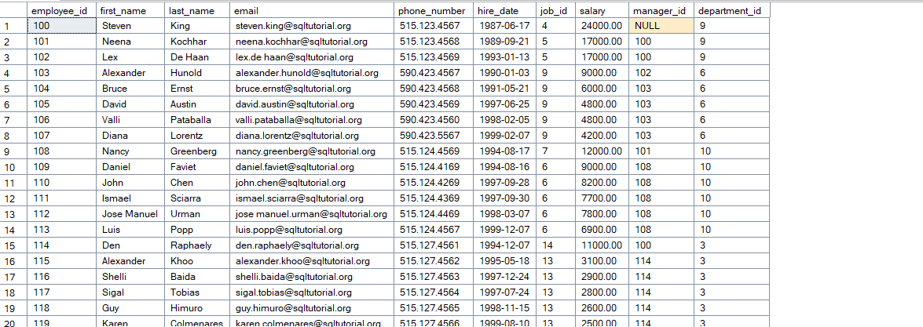
TASK 1: 1)WRITE A QUERY FOR SELECT STATEMENTS :- A. To get data from all the rows and columns in the employees table:

Slide 5
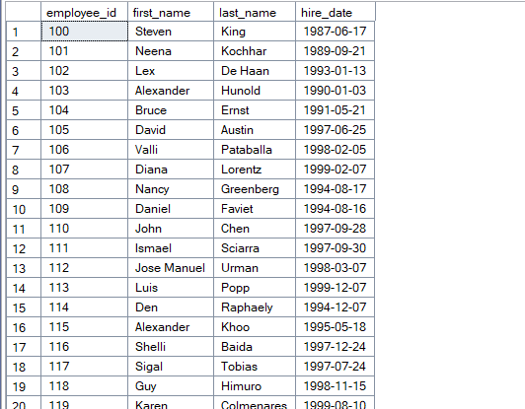
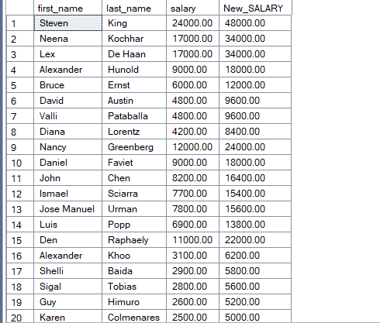
B. select data from the employee id, first name, last name, and hire date of all rows in the employees table:
C. to get the first name, last name, salary, and new salary:

Slide 6
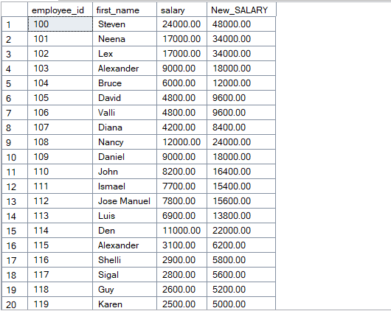
D. Increase the salary two times and named as New_SALARY from employees table

Slide 7
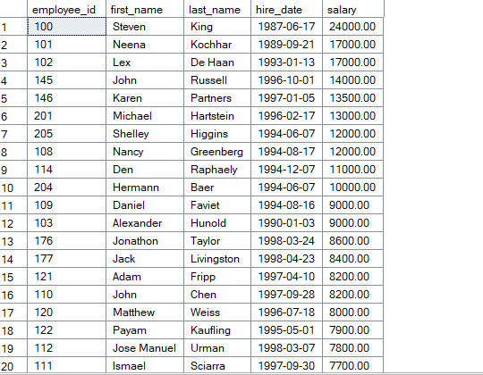
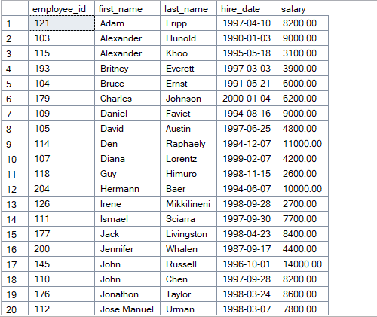
2)WRITE A QUERY FOR ORDER BY STATEMENTS :-
Syntax of ORDER BY Statements:-
A. returns the data from the employee id, first name, last name, hire date, and salary column of the employees table
B. to sort employees by first names in alphabetical order:

Slide 8
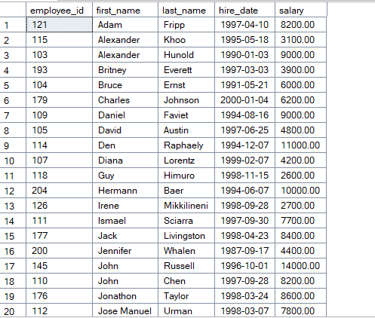
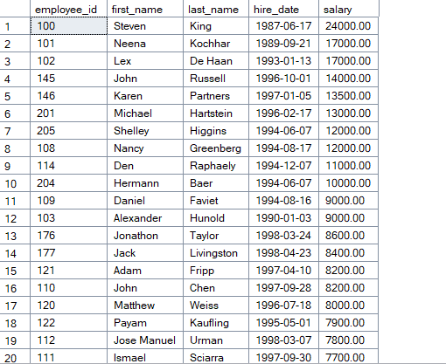
C. to sort the employees by the first name in ascending order and the last name in descending order:
D. to sort employees by salary from high to low:

Slide 9
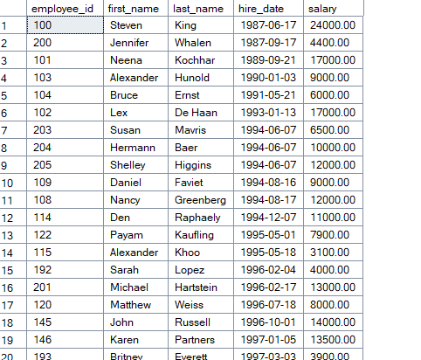
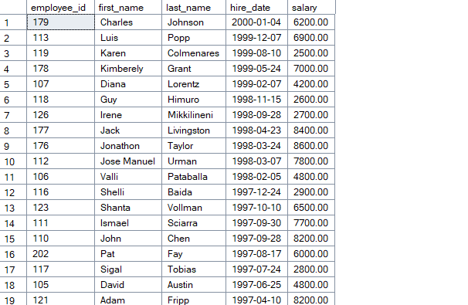
E. to sort the employees by values in the hire_date column from:
F. sort the employees by the hire dates in descending order:

Slide 10
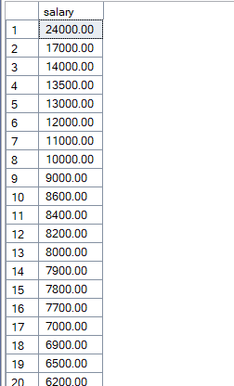
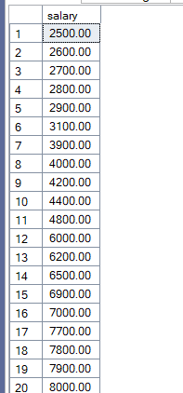
3)WRITE A QUERY FOR DISTINCT STATEMENTS :- Syntax of DISTINCT Statements:-
A. selects the salary data from the salary column of the employees table and sorts them from high to low:
B. select unique values from the salary column of the employees table: C. selects the job id and salary from the employees table: D. to remove the duplicate values in job id and salary: E. returns the distinct phone numbers of employees:

Slide 11
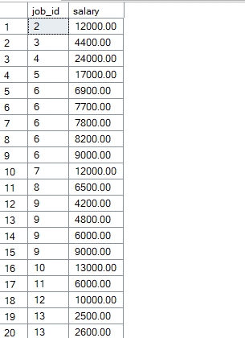
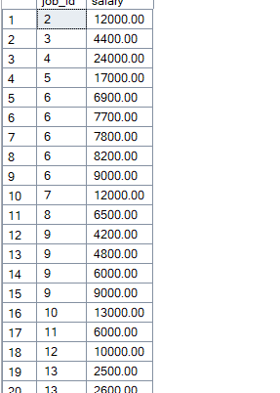
C. selects the job id and salary from the employees table
: D. to remove the duplicate values in job id and salary:

Slide 12
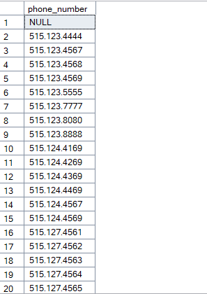
E. returns the distinct phone numbers of employees:

Slide 13
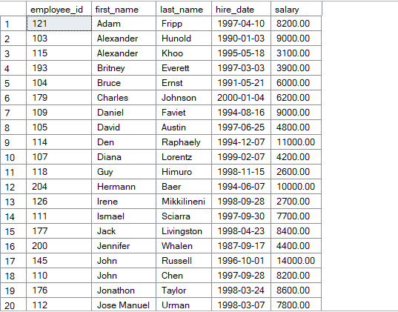
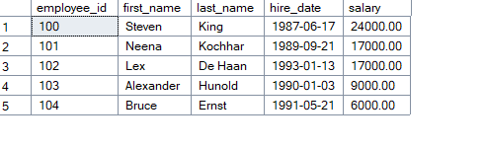
4)WRITE A QUERY FOR TOP N STATEMENTS :- Syntax of TOP N Statements(N=Will be any nos)
A. returns all rows in the employees table sorted by the first_name column.
B. to return the first 5 rows in the result set returned by the SELECT clause:

Slide 14
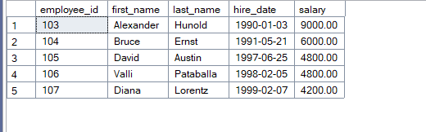
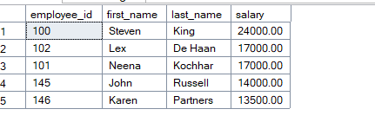
C. to return five rows starting from the 4th row:
D. gets the top five employees with the highest salaries
.

Slide 15
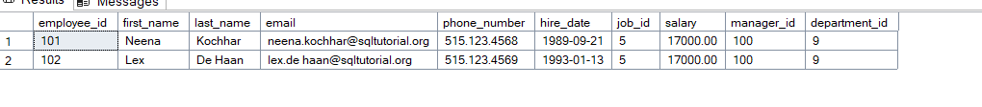


E. to get employees who have the 2nd highest salary in the company
5)WRITE A QUERY FOR WHERE CLAUSE and COMPARISON OPERATORS :- Syntax of WHERE CLAUSE and COMPARISON OPERATORS:--
A. adds a new column named credit_hours to the courses table.
ALTER TABLE courses
ADD credit_hours INT;
B. adds the fee and max_limit columns to the courses table and places these columns after the course_name column.
ALTER TABLE courses
ADD fee DECIMAL(10,2),
max_limit INT;

Slide 16


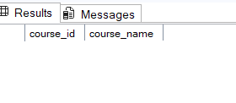
C. changes the attribute of the fee column to NOT NULL.
ALTER TABLE courses
ALTER COLUMN fee DECIMAL(10,2) NOT NULL;
D. to remove the fee column of the courses table E. removes the max_limit and credit_hours of the courses table.
ALTER TABLE courses
DROP COLUMN fee;
E. removes the max_limit and credit_hours of the courses table.
ALTER TABLE courses
DROP COLUMN max_limit, credit_hours;

Slide 17
Methodologies
Database Design The HR database was designed using a relational database model, where different tables such as employees, departments, jobs, locations, and dependents are connected using primary and foreign keys.
Data Organization Data was structured into multiple tables to maintain data integrity and reduce redundancy. Each table stores specific information such as employee details, department data, and salary records.
SQL Query Implementation Various SQL queries were used to retrieve and analyze data from the database. These include SELECT statements, joins, subqueries, and aggregate functions.
Data Analysis Using SQL Functions Aggregate functions such as COUNT, SUM, AVG, MIN, and MAX were used to perform analysis like department headcount, salary calculations, and employee distribution.
Use of SQL Clauses SQL clauses such as GROUP BY, HAVING, WHERE, and ORDER BY were applied to filter, group, and organize the data for meaningful insights.
Advanced Query Techniques Advanced SQL features such as subqueries, CASE expressions, UNION, INTERSECT, EXISTS, and JOIN operations were used to solve complex database queries.
Data Validation and Testing Queries were tested using sample HR data to ensure accurate results and verify that the database structure works correctly.

Slide 18
Approaches
Relational Database Approach The project follows a relational database approach where data is organized into related tables such as employees, departments, jobs, and dependents to maintain structured relationships.
Query-Based Data Analysis SQL queries were used to retrieve and analyze employee data, department details, salary information, and reporting structures from the database.
Join Operations for Data Integration Different types of joins such as INNER JOIN, LEFT JOIN, RIGHT JOIN, and CROSS JOIN were used to combine data from multiple tables and generate meaningful insights.
Aggregation and Grouping Aggregate functions along with GROUP BY and HAVING clauses were used to summarize data, such as calculating department-wise employee count and salary statistics.
Subquery Approach for Complex Analysis Subqueries were used to solve complex problems such as identifying employees with salaries higher than the average salary or employees working in specific locations.
Conditional Logic Implementation SQL CASE expressions were applied to categorize data, for example classifying employee salaries as Low, Average, or High.
Result Validation and Optimization The results of SQL queries were verified and optimized to ensure accurate and efficient data retrieval from the HR database.

Slide 19
Insights
Department Workforce Trends The analysis revealed that some departments have significantly more employees than others, indicating areas with higher operational workload.
Salary Distribution Patterns Salary analysis showed noticeable differences between departments and job roles, helping identify departments with higher compensation levels.
Organizational Hierarchy Understanding By analyzing manager and employee relationships, the structure of reporting lines within the organization became clearer.
Dependents and Employee Benefits The data highlighted which employees have dependents, which can help HR plan employee welfare programs and benefit policies.
Departmental Salary Expenditure Total salary calculations per department provided insights into how payroll expenses are distributed across the organization.
Location-Based Workforce Insights Identifying employees based on location helps organizations understand where their workforce is concentrated and supports strategic planning for expansion or resource allocation.
Performance and Compensation Indicators Categorizing salaries into different levels helps identify employees who may require performance reviews, promotions, or salary adjustments.

Slide 20
Conclusion
The HR Database Management System project demonstrates how a relational database can be used to efficiently store, manage, and analyze employee-related information. By using SQL queries and database concepts, the system enables effective retrieval of data related to employees, departments, salaries, dependents, and organizational structure.
Through various SQL operations such as joins, subqueries, aggregate functions, and conditional statements, meaningful insights were generated from the HR data. These analyses help in understanding workforce distribution, salary patterns, department performance, and reporting relationships within the organization.
Overall, the project highlights the importance of database systems in supporting HR decision-making and improving organizational data management. It also strengthens practical knowledge of SQL and database design, which are essential skills for data analysis and database management.

